Slide 1
SRP + Stack & RB-Tree
Jonathan Liem Zhuan Kim U1520775F
Nicholas Koh Ming Xuan U1522485D
Group: Swensens
CE4053 Embedded Systems

Slide 2
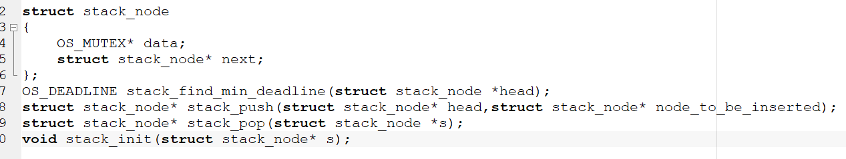
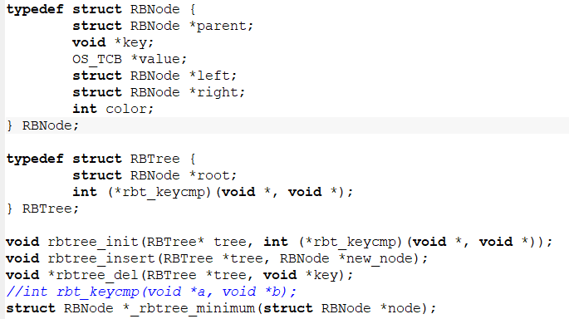
Modifications & Additions
New Data Structures
Stack (for system ceiling)
Push→ inside OSMutexPend()
Pop → inside OSMutexPost()
Red-Black Tree (for blocked tasks)
Unblocking → inside OSMutexPost()
Blocking → inside OSSched()
Modifications to:
OSMutexPend()
OSMutexPost()
OSSched()

Slide 3
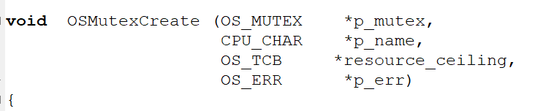
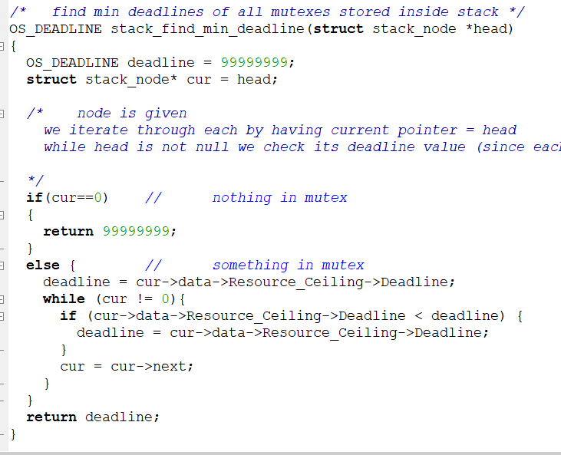
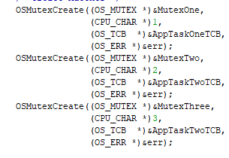
Resource Ceiling
Based on relative deadlines
Assigned before runtime
System Ceiling
Minimum deadline of all tasks currently holding mutexes
Updated in OSMutexPost() & OSMutexPend()

Slide 4
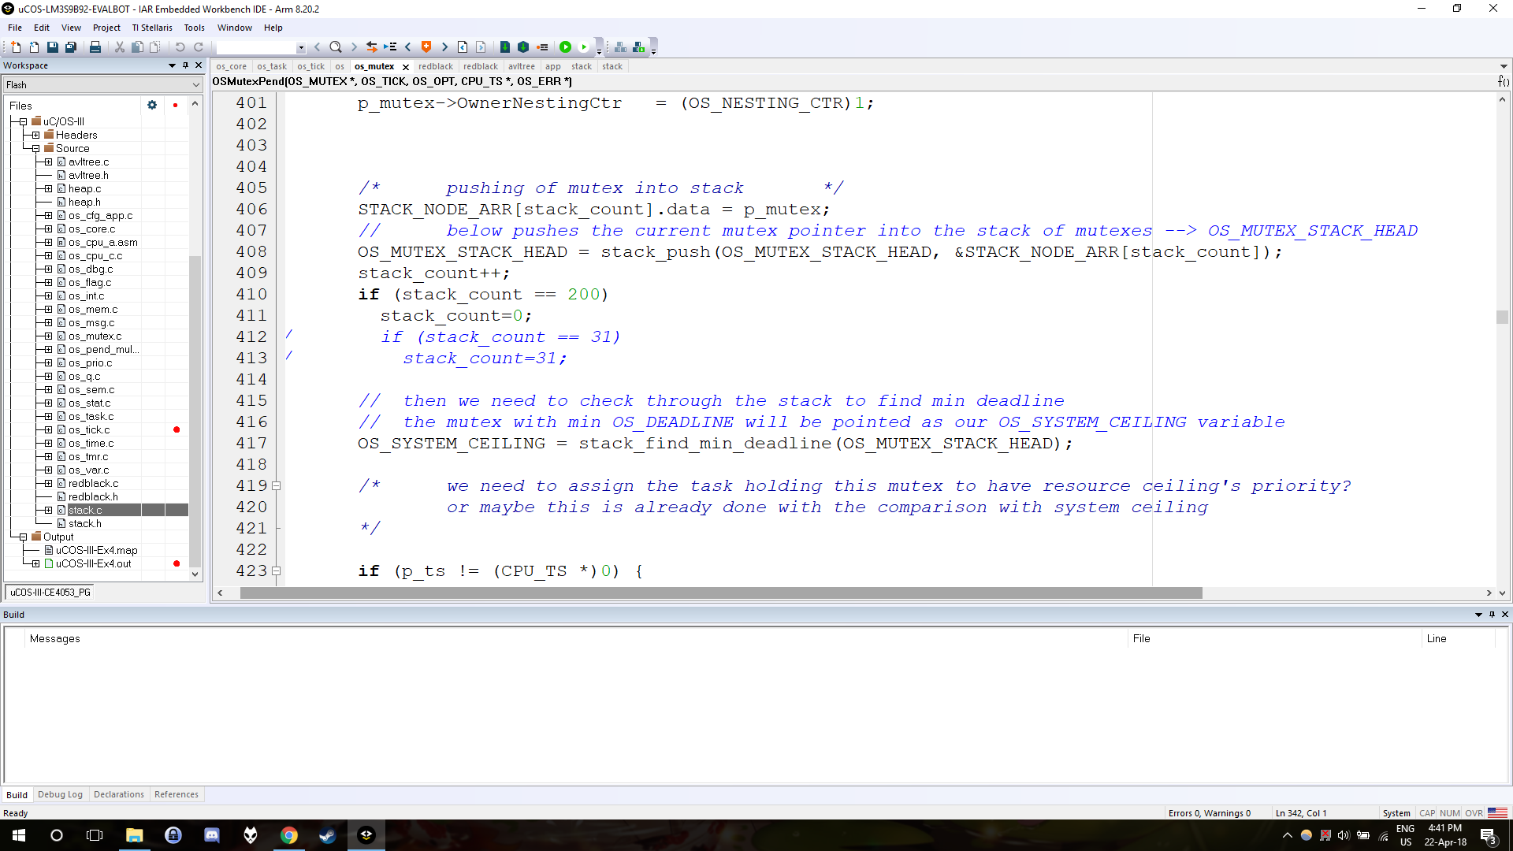
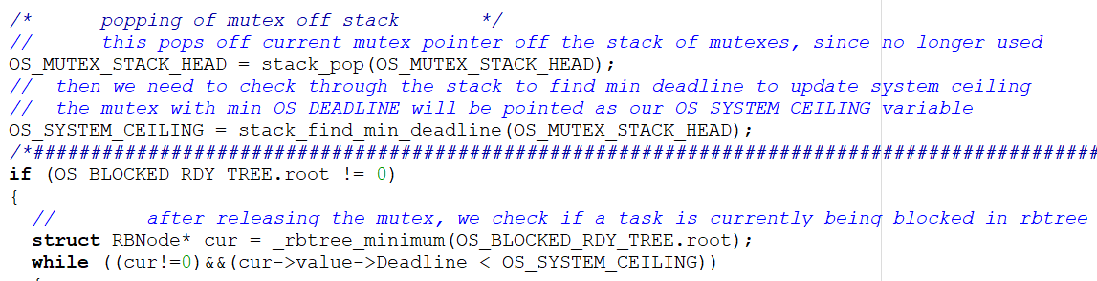
OSMutexPend
OSMutexPost
Push mutex to the stack
Re-calculate system ceiling
Pop mutex
Re-calculate system ceiling
Unblock tasks from Red-Black tree (if applicable)

Slide 5
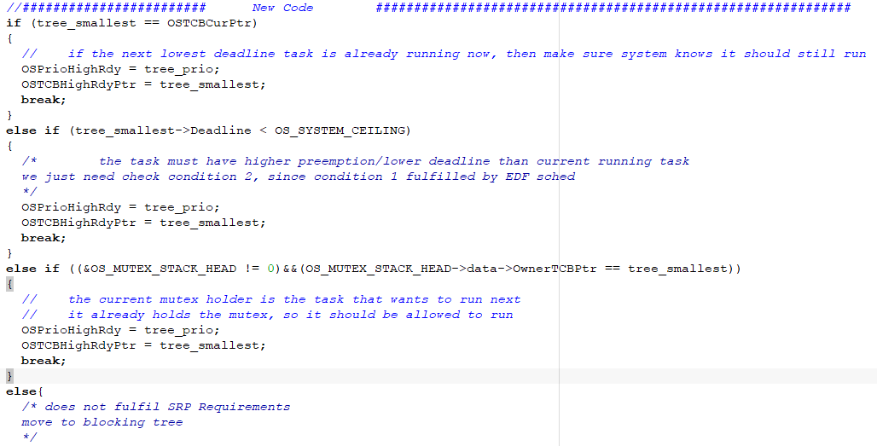
OSSched()
After EDF selects task to run
Check if deadline is smaller than system ceiling
OR if task is the current mutex owner (allow it to resume)
OR block task
If task fails all checks, start from top

Slide 6
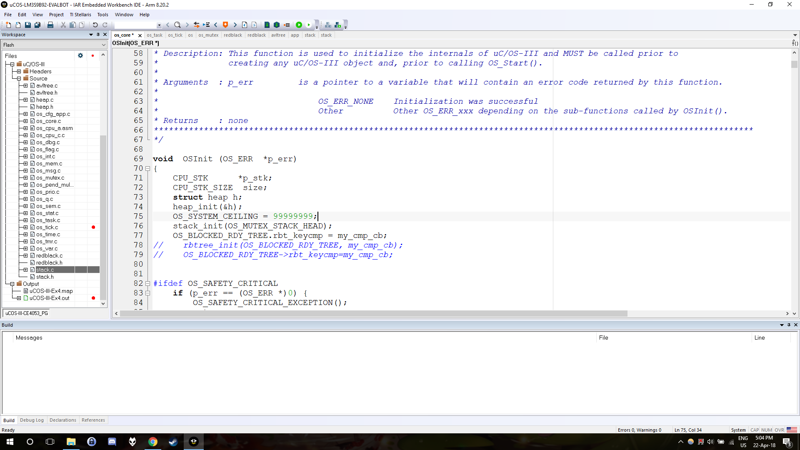
SRP Details in Micrium
System Ceiling by default is a large number, at start and when no mutexes are owned by anyone
Tasks are not allowed to run AT ALL if their deadline is NOT smaller than the system ceiling
Unblocking/Blocking of tasks are accompanied by addition/removal of tasks from the AVL tree and Ready List.

Slide 7
Function | Time (cycles) | Function | Time (cycles) | Function | Time (cycles)
OS_revive_rec_task (sync release tasks) | 1291 | OSSched (without EDF) | 116 | OSMutexPend | 225
OS_revive_rec_task (revive recursive task) | 1925 | OSSched (with EDF) | 277 | OSMutexPost | 168
OS_revive_rec_task (no tasks to revive) | 37 | stack_push | 37 | stack_pop | 29
rbtree_insert | 140 | rbtree_del | 200

